Slide 1
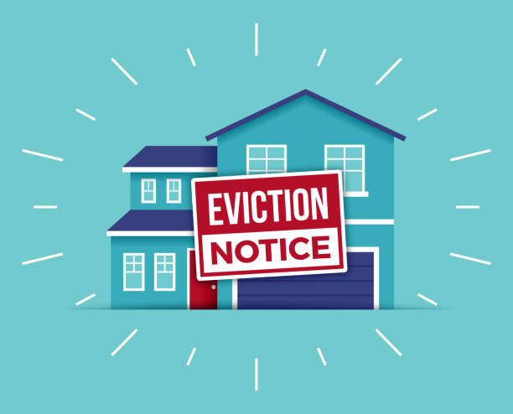
Uncovering The Truth Behind NYC's Evictions
Bitan Kar, Jessi Wu, Meghna Dev, Jahir Strong

Slide 2
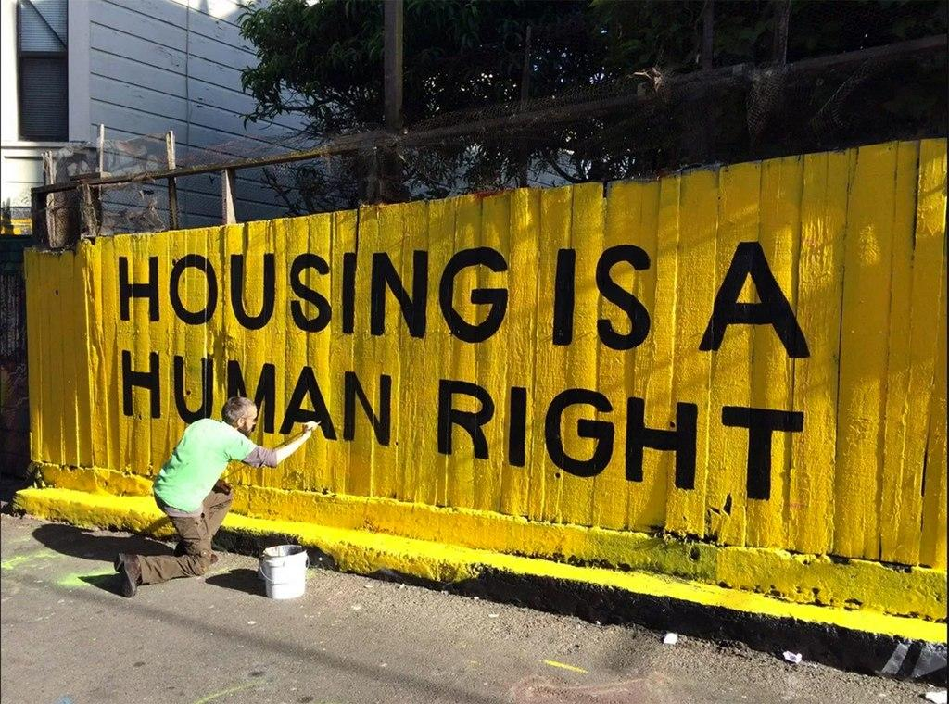
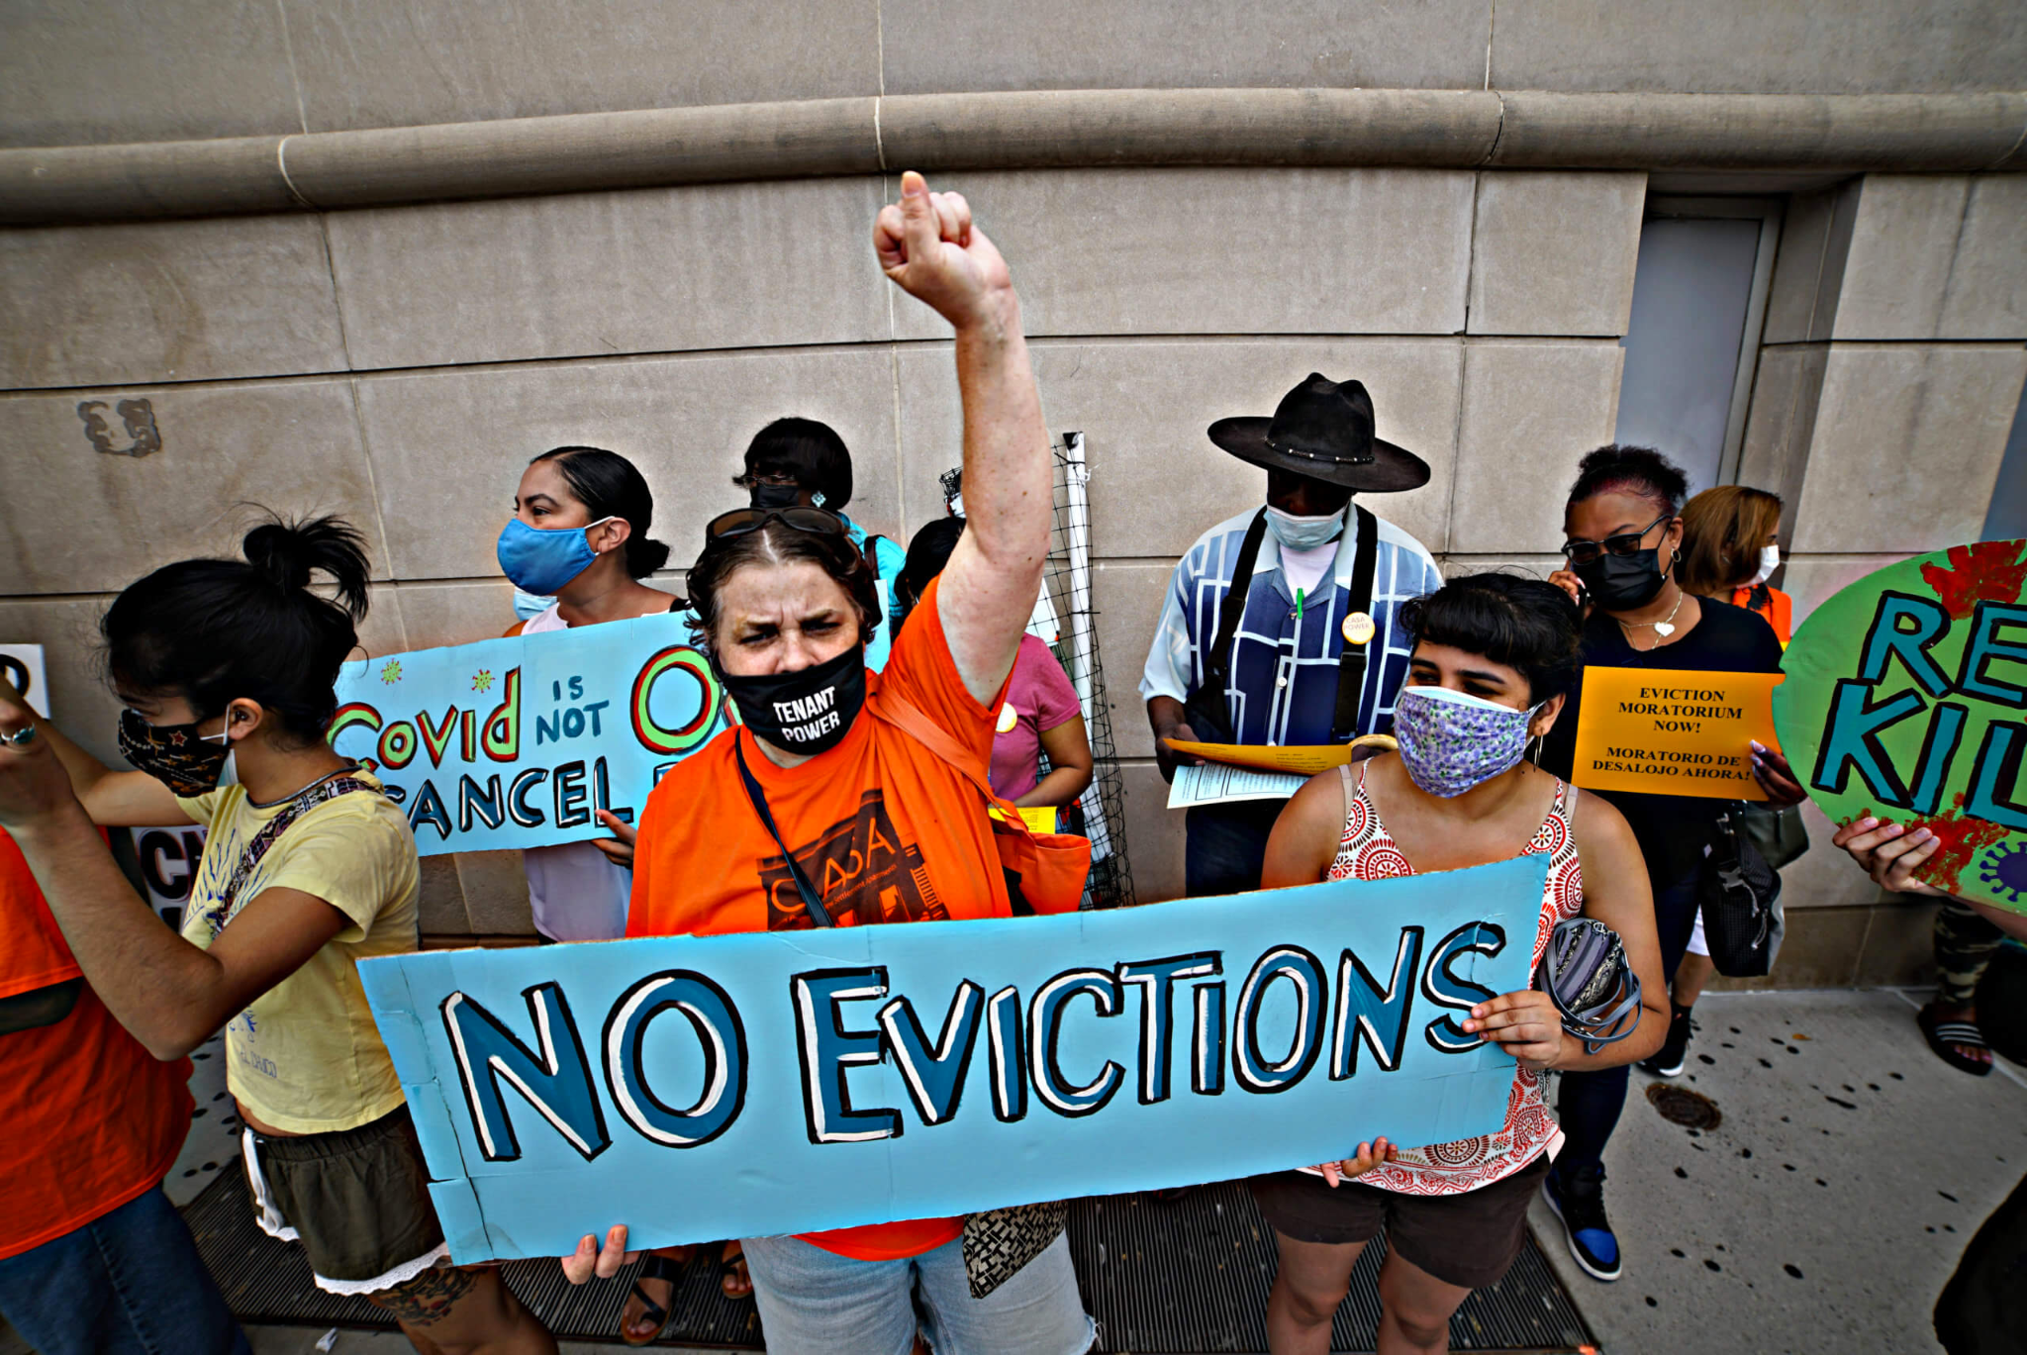
Introduction
We chose to focus on evictions in New York City because of the current ongoing housing crisis.
We used Google Sheets and Python to clean our data and Tableau to perform our analysis & create all the data visualizations
Notes:
Jessi
Housing in New York City has long been a pressing issue due to high demand and limited supply, resulting in sky-high prices and a lack of affordable options for many residents.

Slide 3

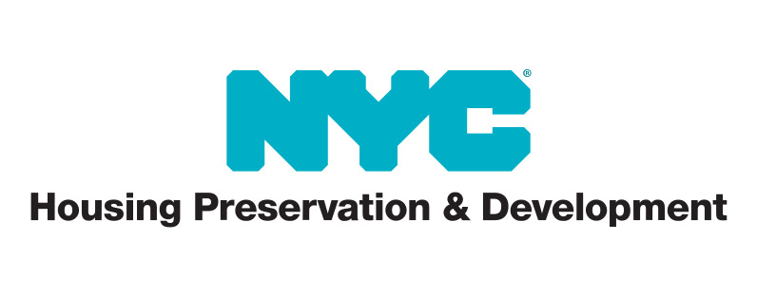
Our Client
Purpose of our Exploratory Analysis
NYC Department of Housing Preservation & Development
Commissioner, Adolfo Carrión Jr.
Identify where the most evictions in New York City are occurring
Explore patterns of where and when these evictions are being executed
Establish reasons why these evictions might be happening
Determine if eviction is systemic and if so, can it be predicted?
Generate actionable recommendations for our client.
Notes:
JAHIR
Senior HPD Team: https://www.nyc.gov/site/hpd/about/senior-team.page#:~:text=Adolfo%20Carri%C3%B3n%20Jr.%20is%20the,City%2C%20and%20around%20the%20country.

Slide 4
Outline
Information About Our Data Set
Overview of Evictions In NYC
The Bronx: An Eviction Hotspot
Understanding the Causes of Evictions in the Bronx
Conclusion & Recommendations
Notes:
Meghna Outline
I. Introduction
- Briefly explain the importance of eviction data for NYC Public Housing
- Provide an overview of the data analysis, which will focus on evictions across all five boroughs of NYC
- Provide context, housing crisis and COVID 19 eviction relief
II. Overview of Evictions in NYC
- Present overall statistics on evictions in NYC, such as the total number of evictions, eviction rates, and the reasons for eviction
III. The Bronx: An Eviction Hotspot
- Explain why the Bronx has the largest number of evictions among all NYC boroughs
- Analyze the data to identify the neighborhoods within the Bronx with the highest eviction rates and the most evictions overall
IV. Understanding the Causes of Evictions in the Bronx (Next Steps???)
- Identify the most common reasons for evictions in the Bronx, such as non-payment of rent or lease violations
- Analyze the data to determine whether there are any demographic or socioeconomic factors that contribute to higher rates of eviction in certain neighborhoods or among certain groups of people
V. Implications for NYC Public Housing
- Discuss the implications of the data analysis for NYC Public Housing and its efforts to prevent evictions and homelessness
- Provide recommendations for how NYC Public Housing can use the data to target resources and support to the neighborhoods and households at the highest risk of eviction
VI. Conclusion
- Summarize the key findings of the data analysis and their implications for NYC Public Housing and the broader community
- Emphasize the importance of ongoing data collection and analysis to address the problem of evictions and housing insecurity in NYC.

Slide 5
A Breakdown of Our Dataset

Slide 6
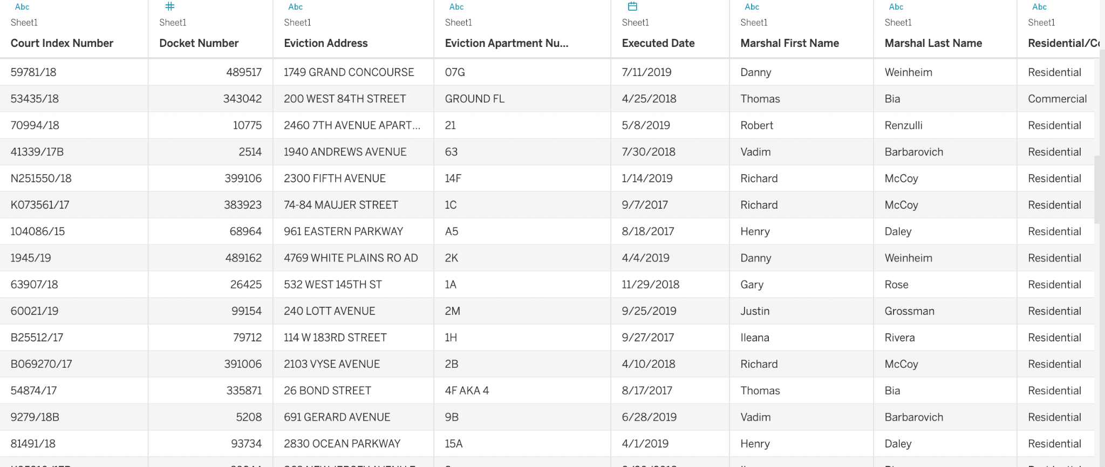
About the Dataset
Provided By
NYC OpenData - Department of Investigation (DOI)
Types of Data
String Data
Date-time objects
Geo-spatial information
Created in: Tableau Public and Google Sheets
Notes:
BITAN
Initial # of entries - 67,729
Number of entries after cleaning: 60,466
While looking at the data we realized a number of entries were missing latitudinal and longitudinal data. After further inspection, we realized that the entries that had that missing data were also missing information such as Community Board (The NYC community board associated with the provided entity location), NTA, The Neighborhood Tabulation Area (NTA) associated with the provided entity location. And The Building Identification Number (BIN) associated with the provided entity location. It is formatted as a seven-digit numerical identifier, which is unique to each building in NYC.
Types of Data:
Execution Date
Address/Postal Code
Type of Building: Residential or Commercial
Borough
Latitude/Longitude
Marshal

Slide 7
An Overview of Evictions in NYC

Slide 8
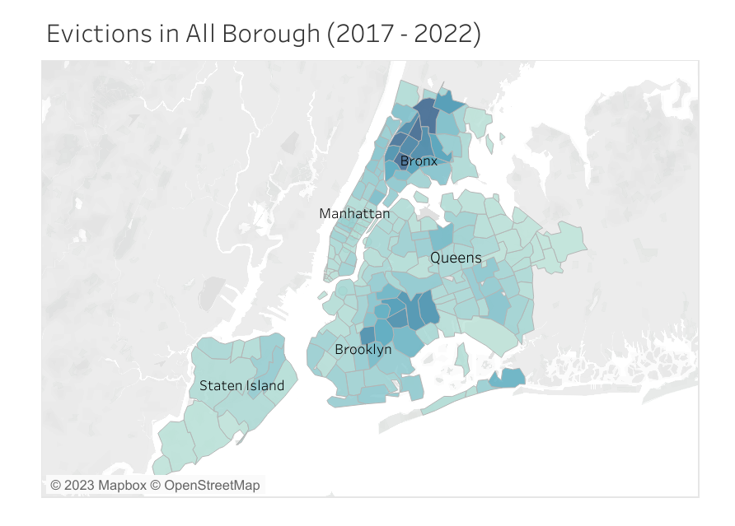
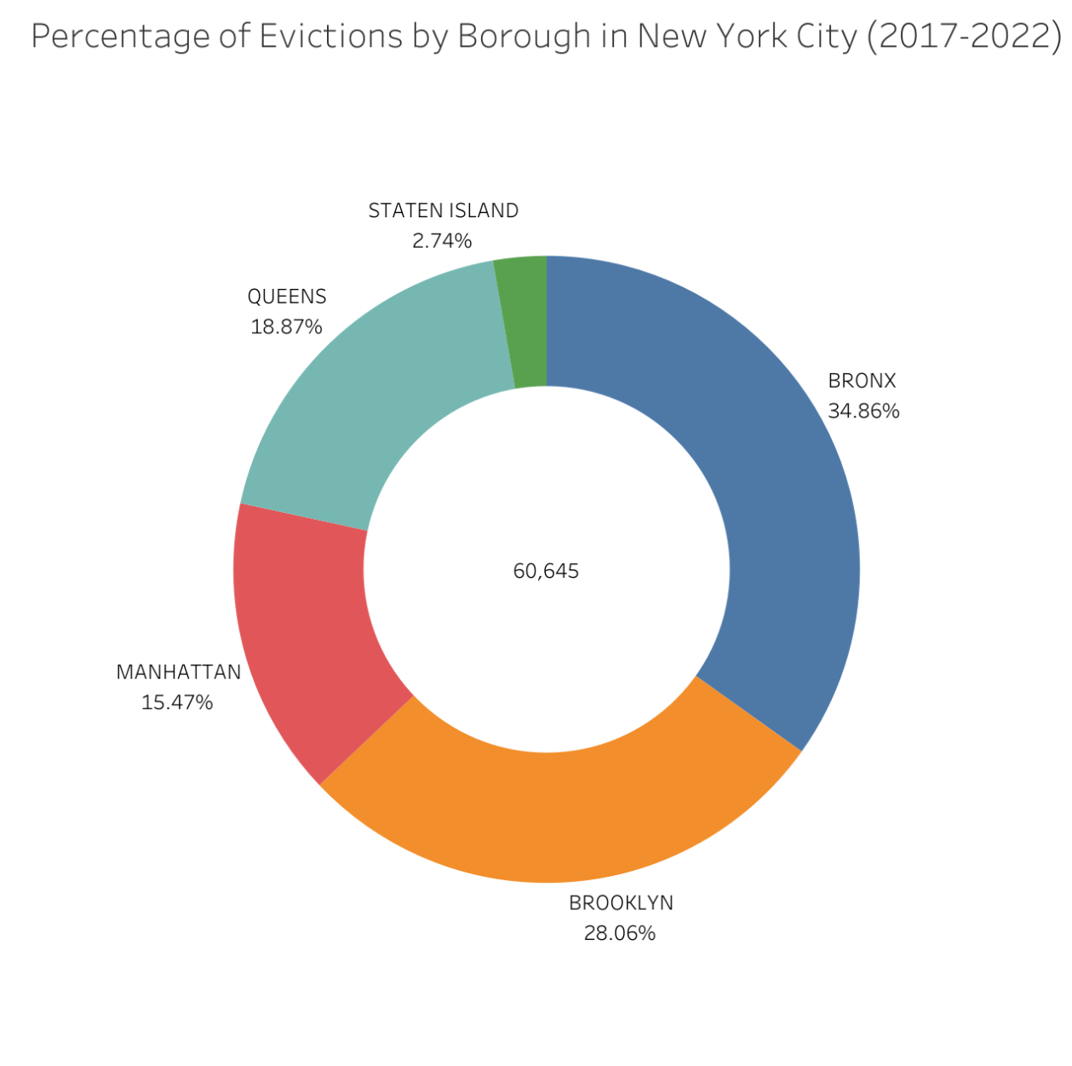
Evictions in New York City (2017-2022)
Created in: Tableau Public
Notes:
Jessi

Slide 9
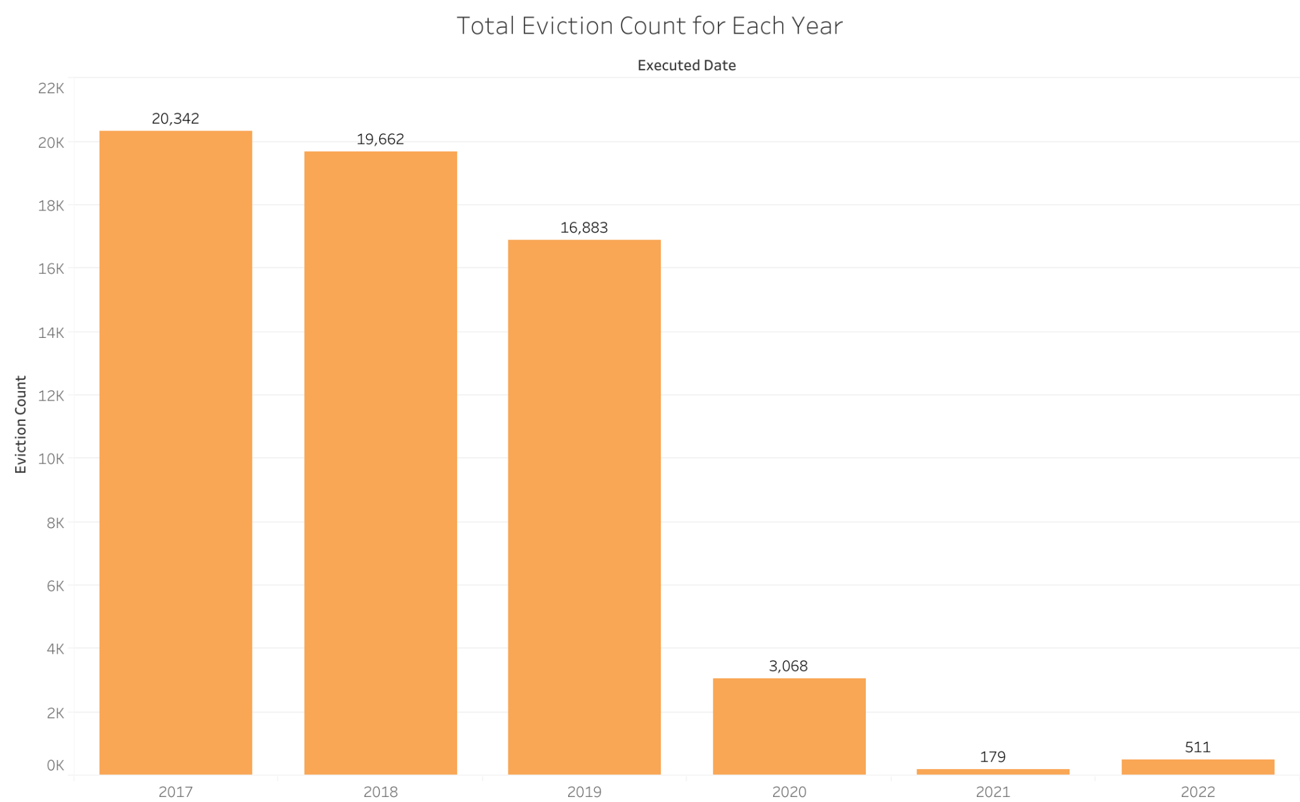
Evictions in New York City (2017-2022)
Created in: Tableau Public
Notes:
Jessi

Slide 10
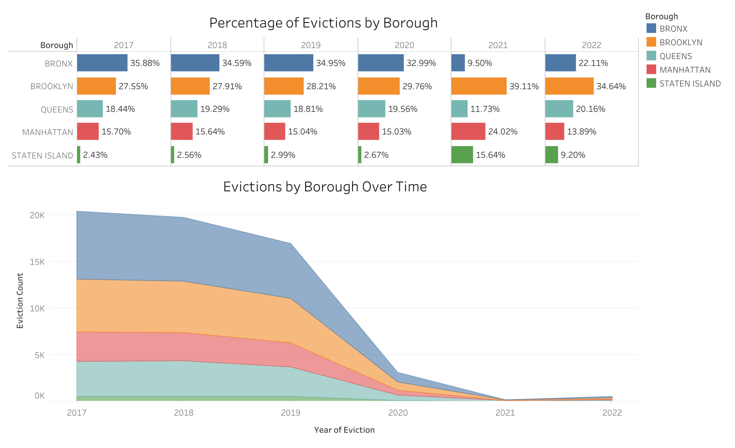
Trend of Evictions Over Time Across the Boroughs
Created in: Tableau Public
Notes:
MEGHNA
Traditionally, Bronx was leading. Later Brooklyn took the lead after the pandemic
Staten Island had a big jump after the pandemic, after traditionally being the lowest

Slide 11
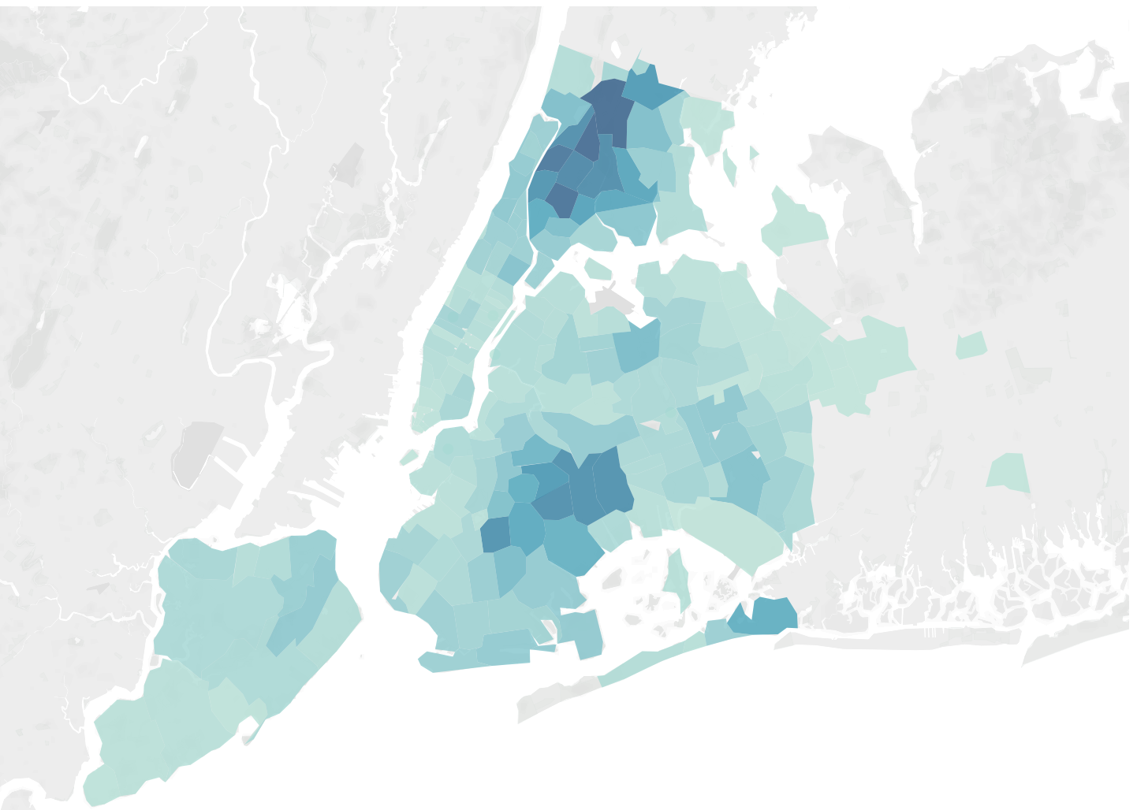
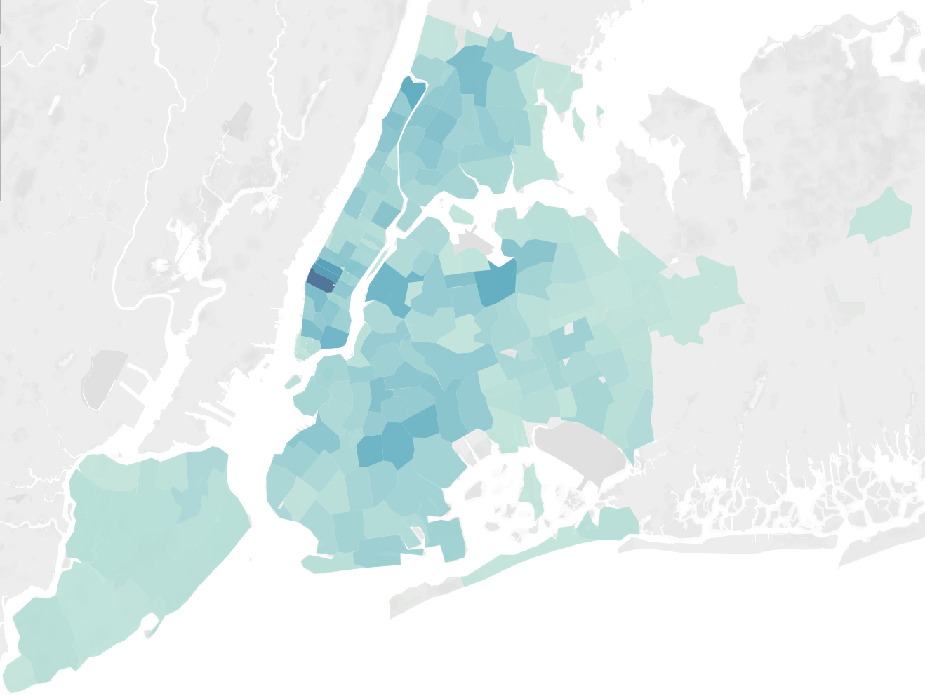
Residential vs. Commercial: 2017-2022
Residential
Commercial
Created in: Tableau Public
Notes:
Bitan
These heat maps show the difference between concentrations of residential and commercial evictions. While residential hotspots include Brooklyn and Bronx, commercial tends to be concentrated in Manhattan.
We can delete this slide and add in our pie chart instead
Bitan

Slide 12
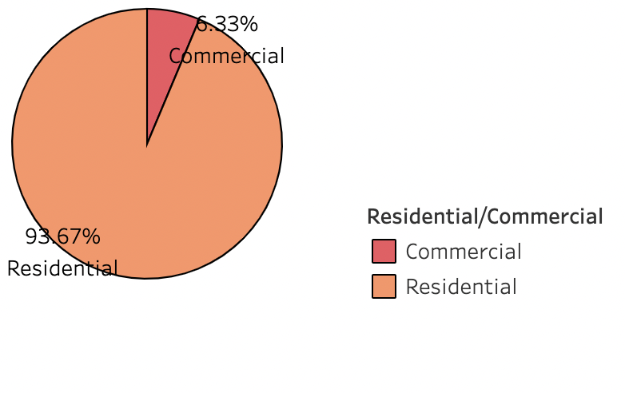
How do eviction rates and patterns differ between commercial vs residential buildings?
Our dataset shows that most of the evictions from 2017 to 2022 have been residential properties.
WHY?
Created in: Tableau Public
Notes:
BITAN
Residential leases are often shorter in duration than commercial leases, which may make it easier for landlords to evict residential tenants who fall behind on rent. Commercial leases typically have longer terms and may include provisions that make it harder for landlords to terminate a lease early.
Commercials businesses also have more monetary resources to fight eviction in court.

Slide 13
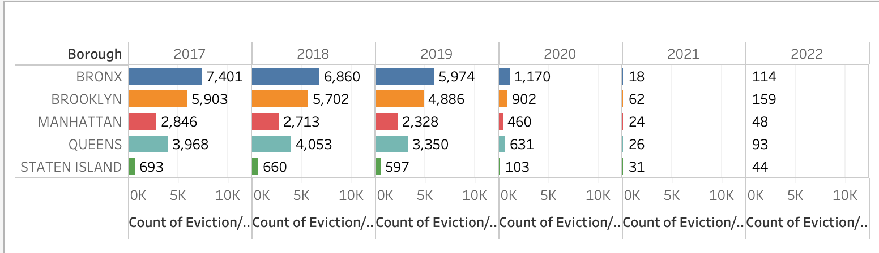
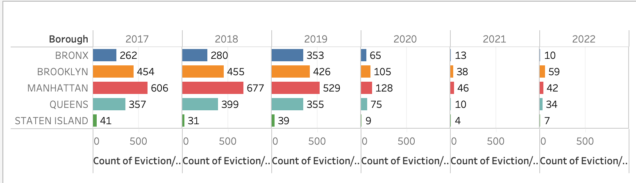
Evictions Across Boroughs Over Time by Property Type
Residential
Commercial
Created in: Tableau Public
Notes:
MEGHNA
Insights
Like noted earlier, we notice that Brooklyn leads in 2021 for residential, as well as in 2022 for commercial. Local Business in Grand Central and Midtown East are dependent on office workers.
Less foot traffic
Increased lease prices
Increase in WFH
Surrounding businesses
https://nypost.com/2021/10/07/midtown-has-highest-retail-vacancy-rate-in-nyc-report/

Slide 14
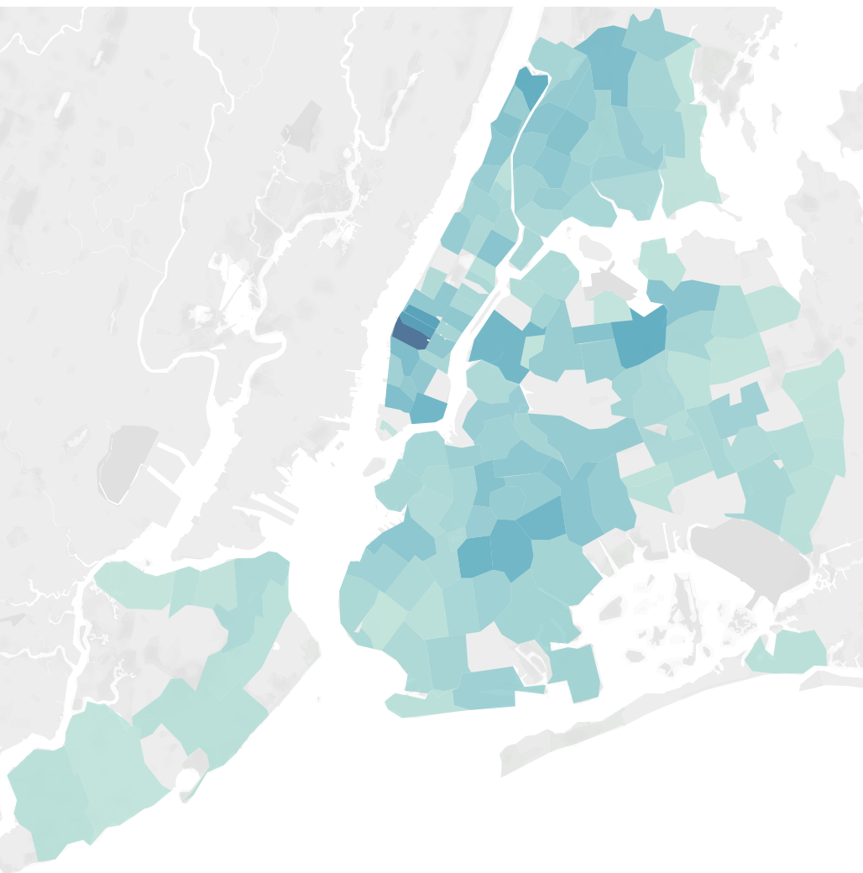
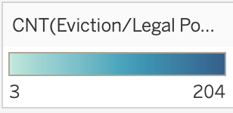
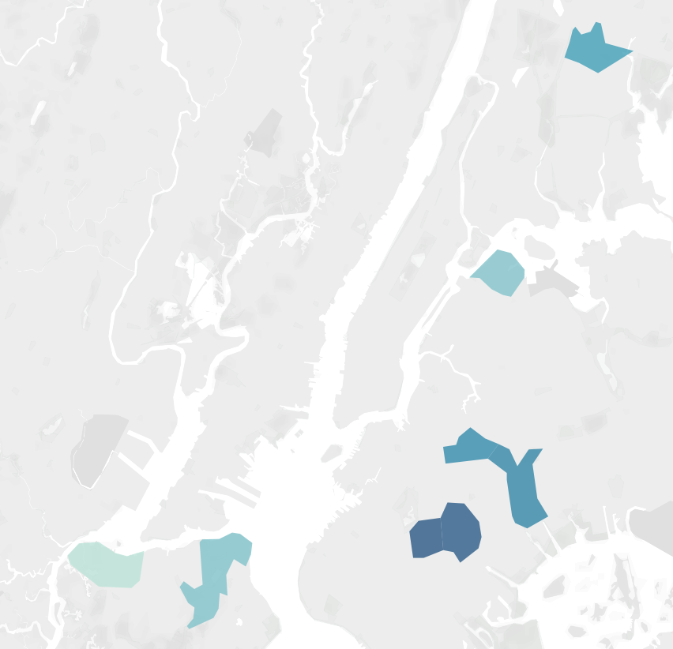
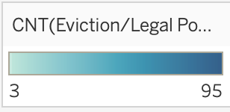
Mar. 2020 vs. Dec. 2020
Effects of Eviction Moratoriums during the Pandemic
Created in: Tableau Public
Notes:
MEGHNA
This heatmap show how quickly eviction rates fell from March 2020 to December 2020. At the start COVID-19 pandemic in March 2020, NY state and city governments implemented several measures to protect renters from eviction. The eviction moratoriums prohibited landlords from evicting tenants for nonpayment of rent and provided temporary relief to renters who were facing financial hardship due to the pandemic. The first eviction moratorium was implemented in March 2020 by the New York State Court, which suspended eviction proceedings and issued a statewide moratorium on evictions for 90 days. This moratorium was later extended multiple times throughout the year. Additionally, the federal government implemented a nationwide eviction moratorium in September 2020, which further protected renters from eviction for nonpayment of rent through the end of the year.
NOTES: TAKE OUT NOV 2020 ITS REDUNDANT

Slide 15
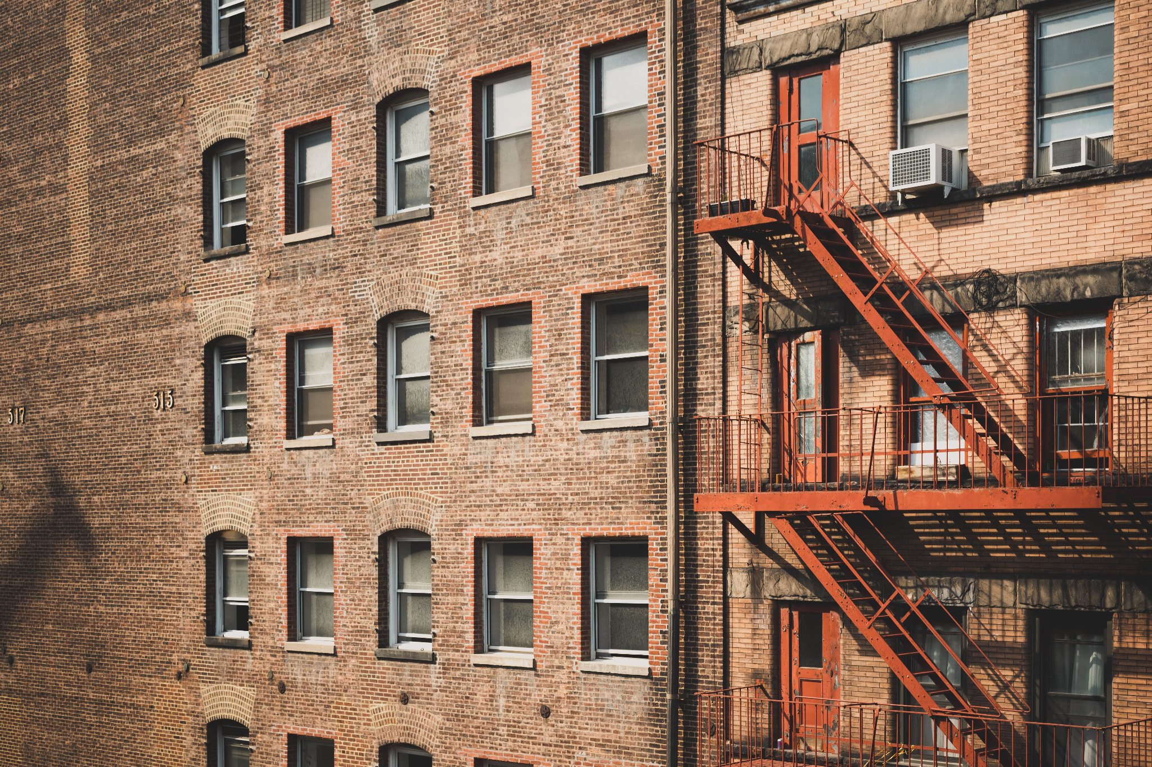
Data Context : COVID-19 Tenant Protection
Notes:
Meghna
Summary of the text in RED:
The COVID-19 pandemic further exacerbated the housing crisis in NYC, with many people losing their jobs and struggling to pay rent. The city implemented measures to protect renters, such as eviction moratoriums and rental assistance programs. In 2020, the COVID-19 Tenant Protection Act was passed, which includes a moratorium on evictions for financially impacted tenants, a ban on late fees for missed rent, and the option for temporary suspension of rent payments. Landlords are also prohibited from reporting non-payment of rent during the pandemic to credit agencies.
The COVID-19 Tenant Protection Act is a law passed in New York State in 2020 in response to the COVID-19 pandemic. The law provides several protections for residential tenants who have been impacted by the pandemic. Some of the key provisions of the law include a moratorium on residential evictions for tenants who have experienced financial hardship due to the pandemic,
-as well as a ban on landlords charging late fees or penalties for missed rent payments during the pandemic.
Under the law, tenants who have experienced financial hardship due to COVID-19 can also request a temporary suspension of rent payments, which they will have to pay back over time, starting in 2021. The law also prohibits landlords from reporting non-payment of rent during the pandemic to credit reporting agencies, which could have a negative impact on a tenant's credit score.
Source: https://hcr.ny.gov/covid-19-eviction-protections-tenants

Slide 16
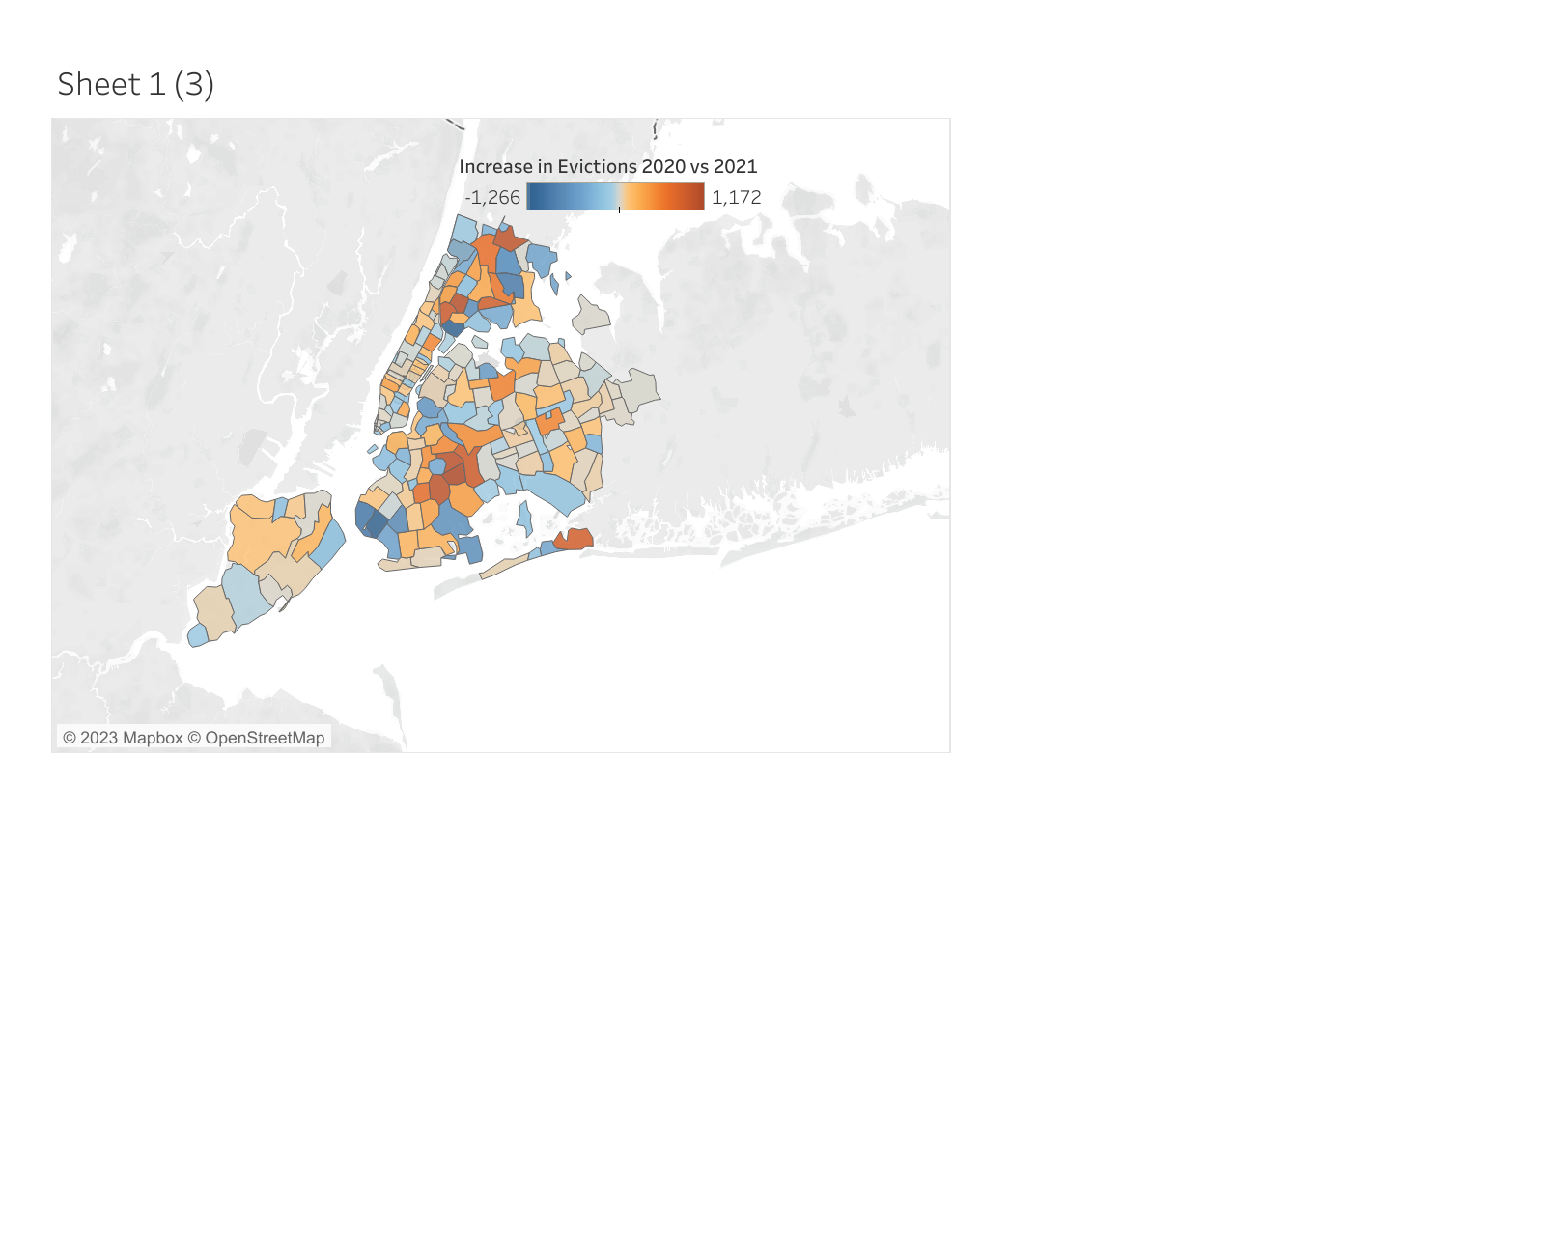
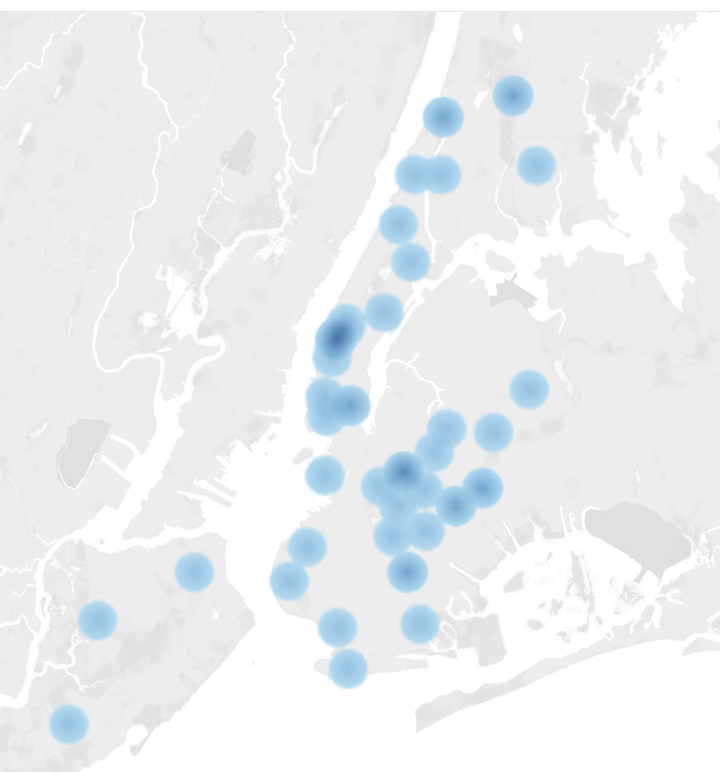
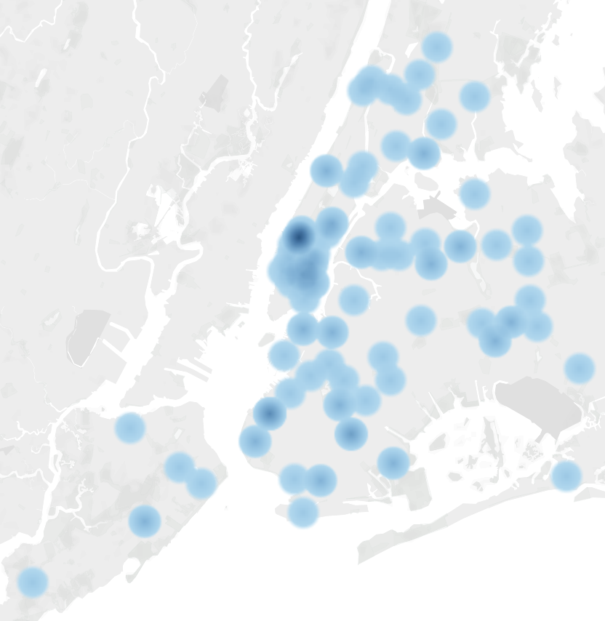
CHANGE IN EVICTION 2020 VS 2021 VS 2022
2020 vs 2021
2021
2022
Eviction has gone up in the same neighborhoods as before the pandemic
Created in: Tableau Public
Notes:
BITAN -
In New York City, the statewide eviction moratorium was extended several times and eventually expired on August 2021. The federal eviction moratorium was also extended several times before it was expired on July 2021. As a result of the expiration of eviction moratoriums, there has been an increase in overall evictions. Landlords were now able to legally evict tenants who have fallen behind on their rent, resulting in many tenants losing their homes.

Slide 17
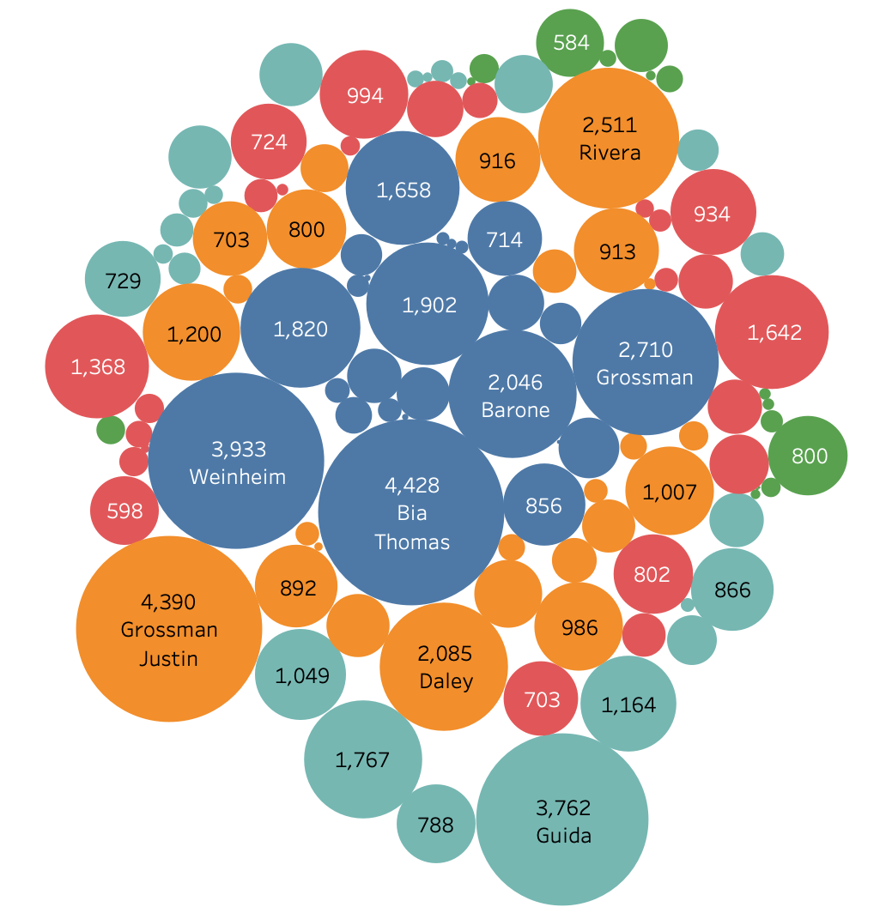
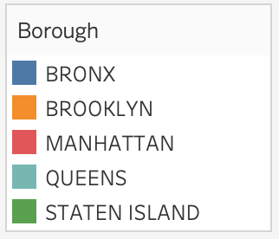
Evictions by Marshal
Notes:
Justin Grossman had the greatest number of evictions, mainly concentrated in Bronx and Brooklyn

Slide 18
The Bronx: An Eviction Hotspot
Notes:
JAHIR

Slide 19
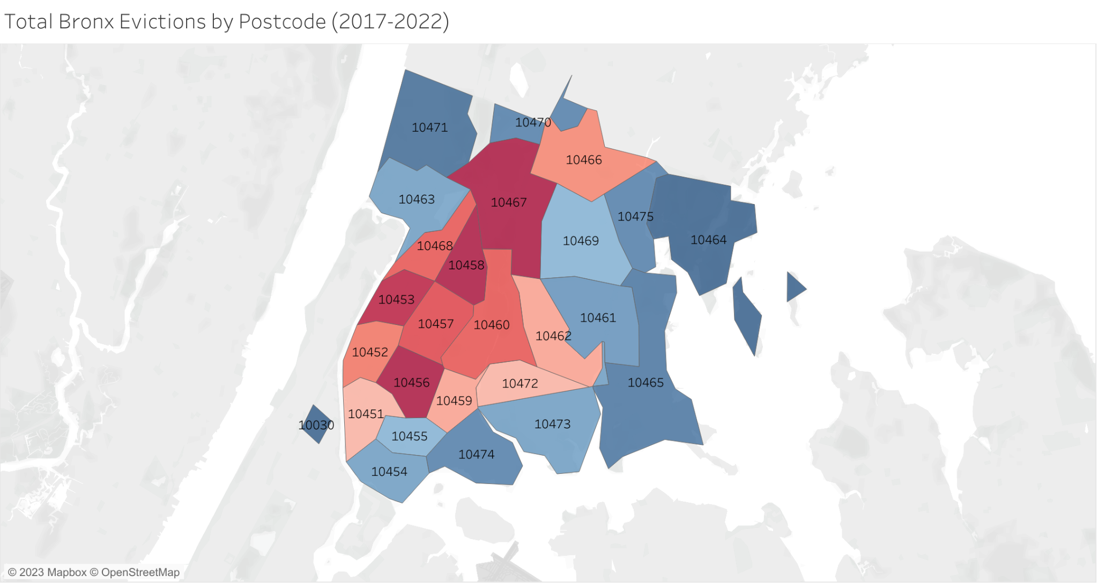
Eviction Postcode | # of Evictions
10458 | 1751
10467 | 1733
10456 | 1700
10453 | 1617
10457 | 1396
Created in: Tableau Public
Notes:
Top 5 eviction hotspots from all years

Slide 20
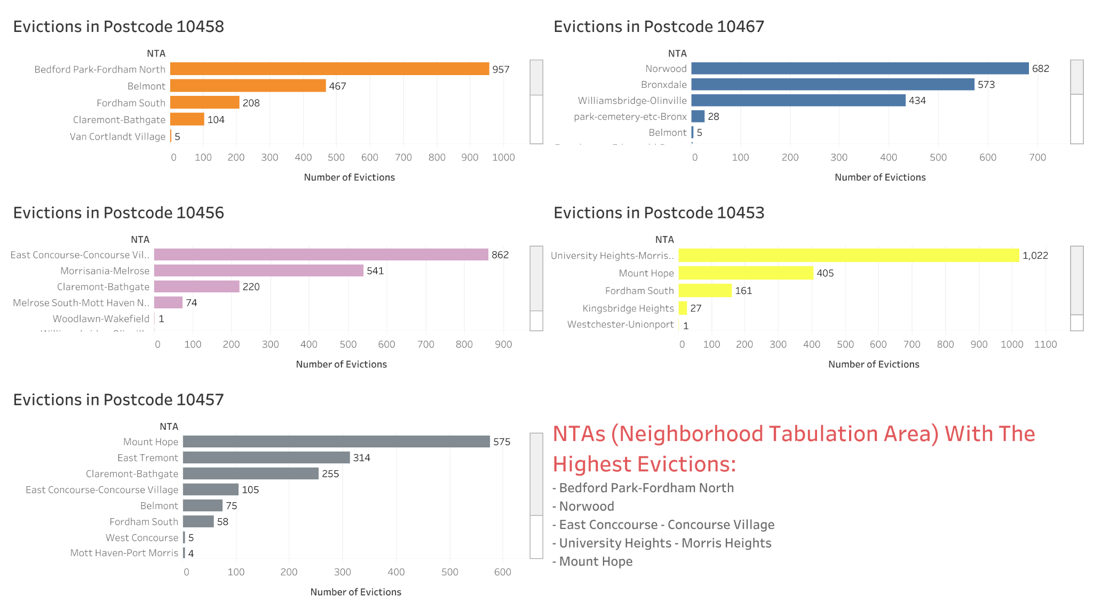
Postcode Hotspots from 2017-2022
Created in: Tableau Public
Notes:
Looking at other features: NTA (neighborhood tabulation area), BIN (The Building Identification Number (BIN) associated with the provided entity location. It is formatted as a seven-digit numerical identifier, which is unique to each building in NYC.) Are these evictions occuring in the same building?

Slide 21
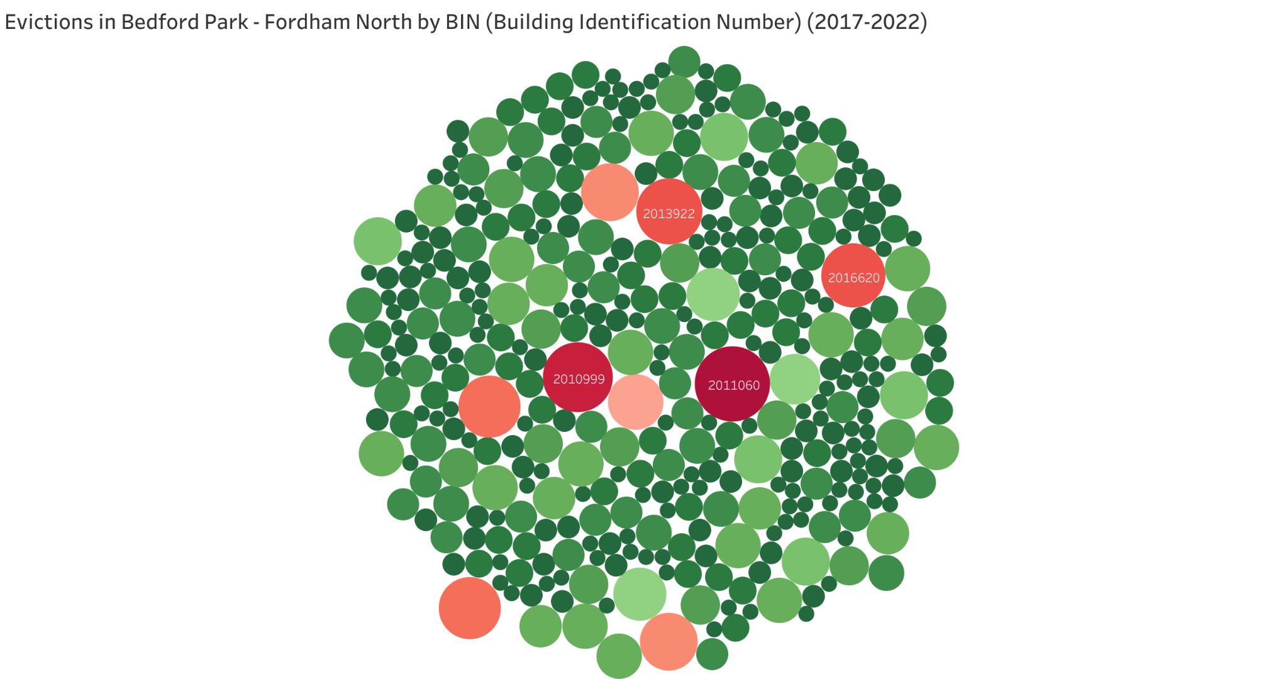
BIN 2011060 had 22 evictions
Created in: Tableau Public
Notes:
Exploration of BIN in other neighborhood -

Slide 22
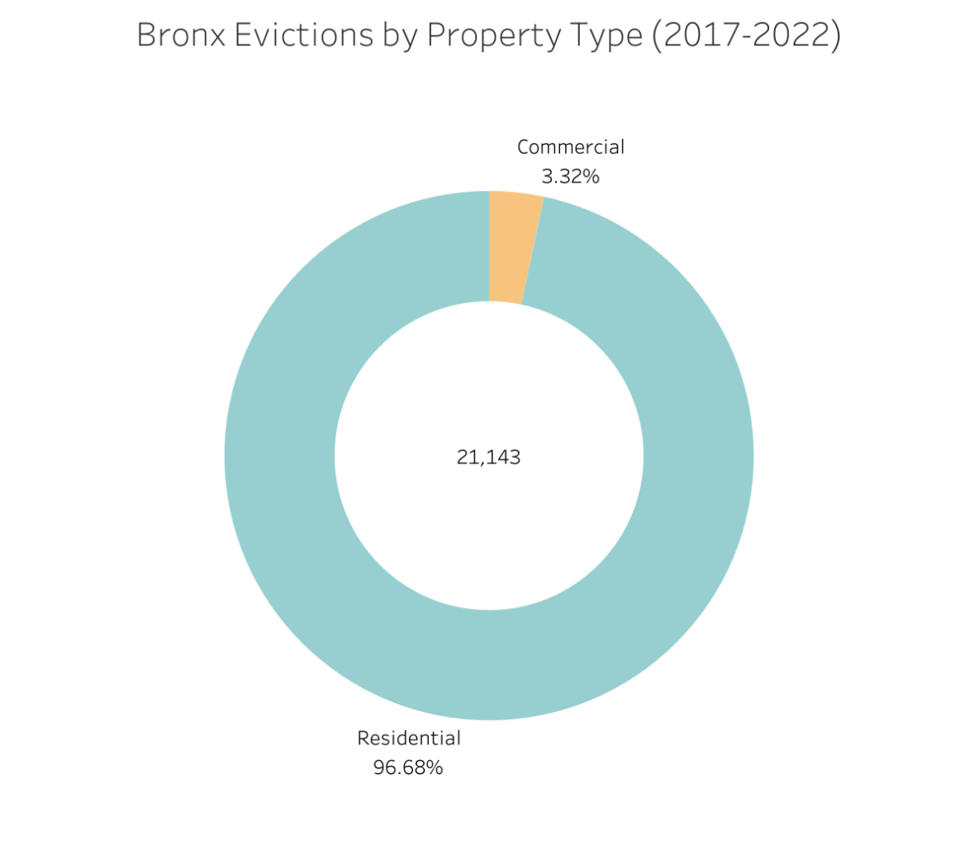
Created in: Tableau Public

Slide 23
Understanding other Factors of Evictions in NYC

Slide 24
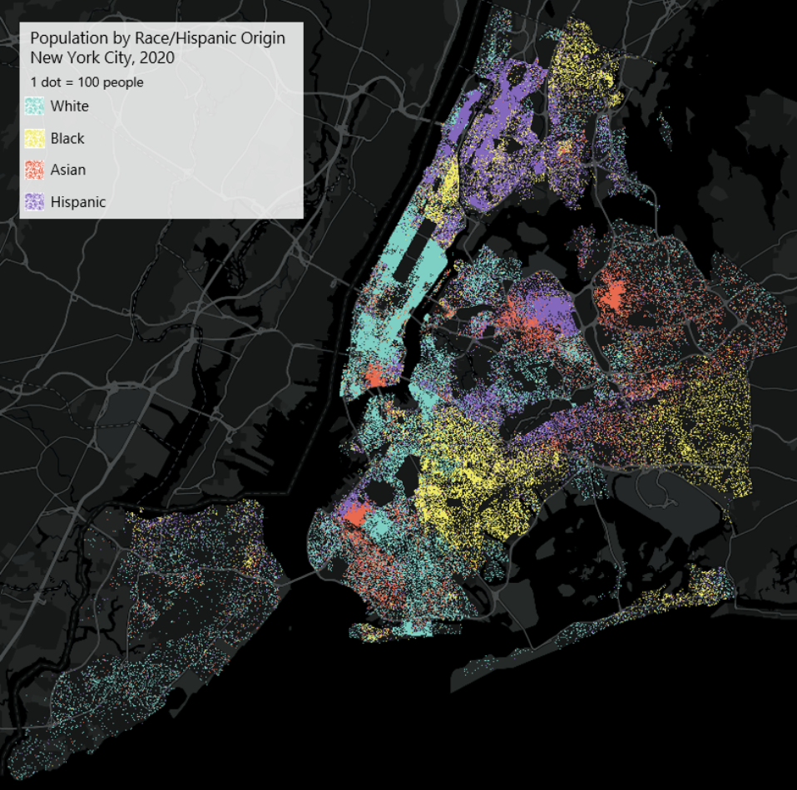
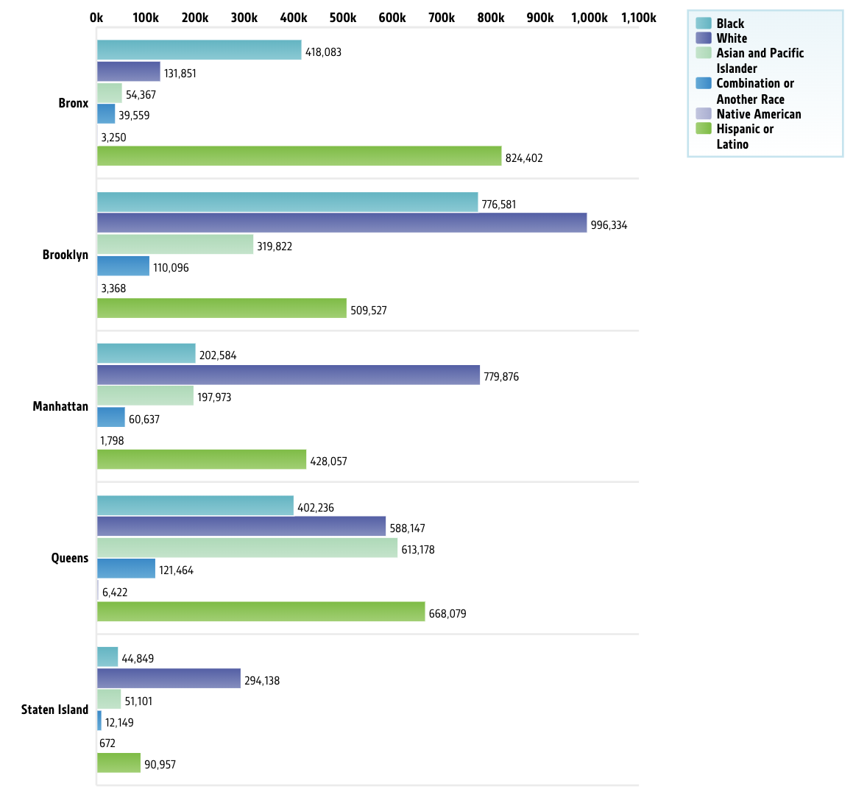

Racial Composition of NYC Neighborhoods
Source: Citizens’ Committee for Children of New York
Source: nyc.gov
Notes:
^{MEGHNA}
¹https://www.nyc.gov/site/planning/planning-level/nyc-population/2020-census.page

Slide 25
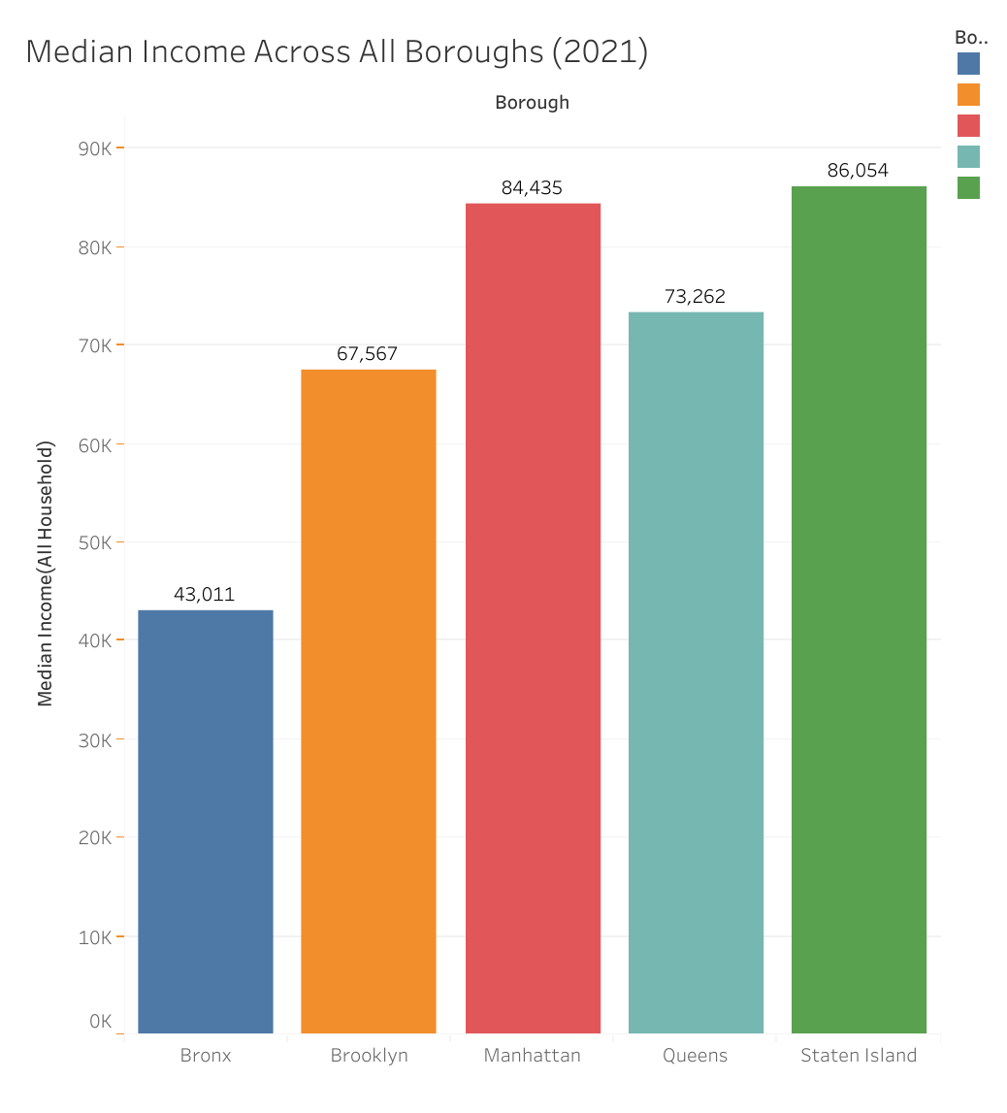
Median Income Across NYC (2021)
Bronx has the LOWEST and Staten Island has the HIGHEST Median Income across all Boroughs!
Source: U.S. Census Bureau, American Community Survey 1-Year Estimates, Table S1903 (2005-2019, 2021); retrieved from https://data.census.gov/.
Notes:
BITAN - ADDING A BAR GRAPH FOR MEDIAN INCOME BY EACH BOROUGH
Source: U.S. Census Bureau, American Community Survey 1-Year Estimates, Table S1903 (2005-2019, 2021); retrieved from https://data.census.gov/.

Slide 26
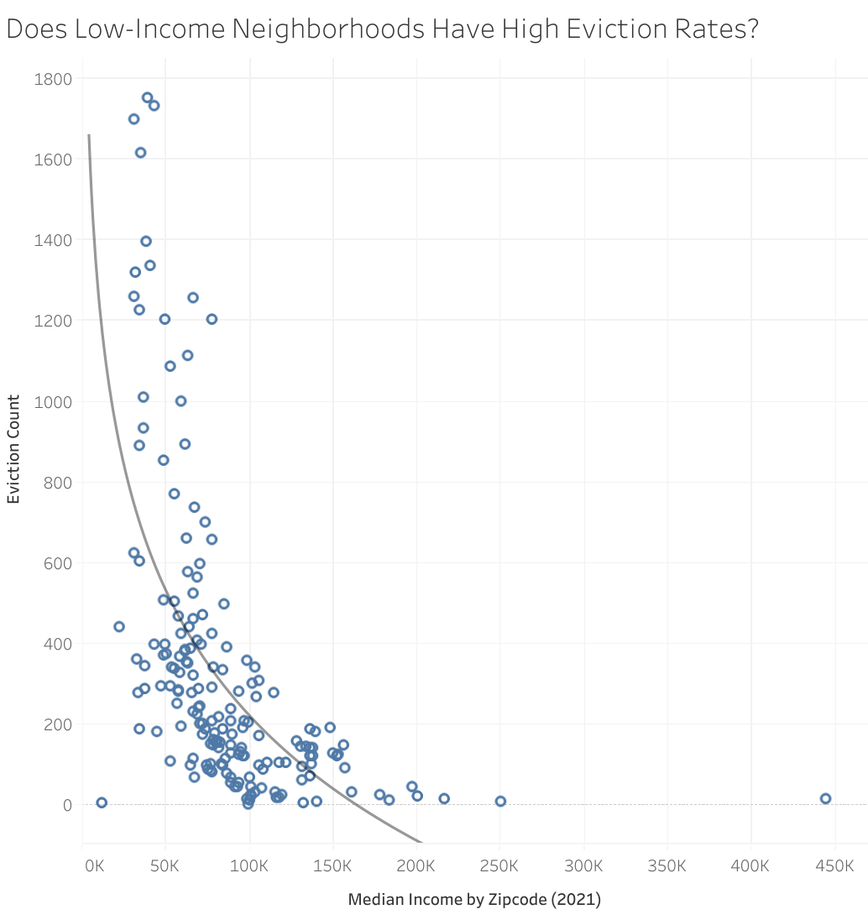
Does Low-Income Neighborhoods Have High Eviction Rates?
Source: https://data.census.gov/
Notes:
People who are lower income tend to be located to higher evicted zipcodes Latest - COMBINE WITH PREVIOUS SLIDE

Slide 27
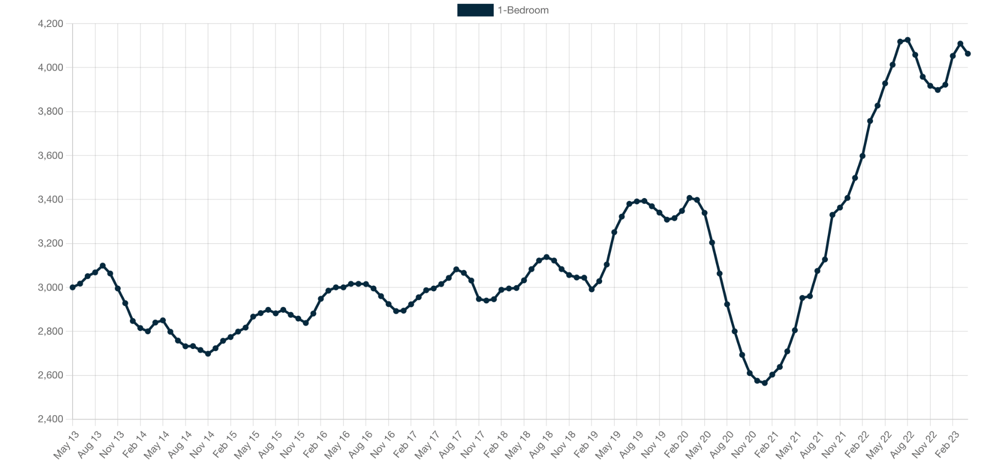
Average Rent for a 1-Bed Apartment in NYC
The Average rent for a one-bedroom NYC apartment over the last decade
SOURCE: RENTHOP.COM
Notes:
Jessi
How does Average rent relate to eviction rates in nyc?
Generally speaking, areas with higher average rent tend to have higher eviction rates, as tenants in these areas may struggle to keep up with the high cost of living. This can lead to non-payment of rent, which is one of the most common reasons for eviction in NYC.
Overall, the relationship between average rent and eviction rates in NYC highlights the importance of addressing issues related to affordable housing and tenant protections. This can include efforts to increase affordable housing options, provide legal assistance to tenants facing eviction, and enact policies that protect tenants from unfair or discriminatory practices by landlords.

Slide 28
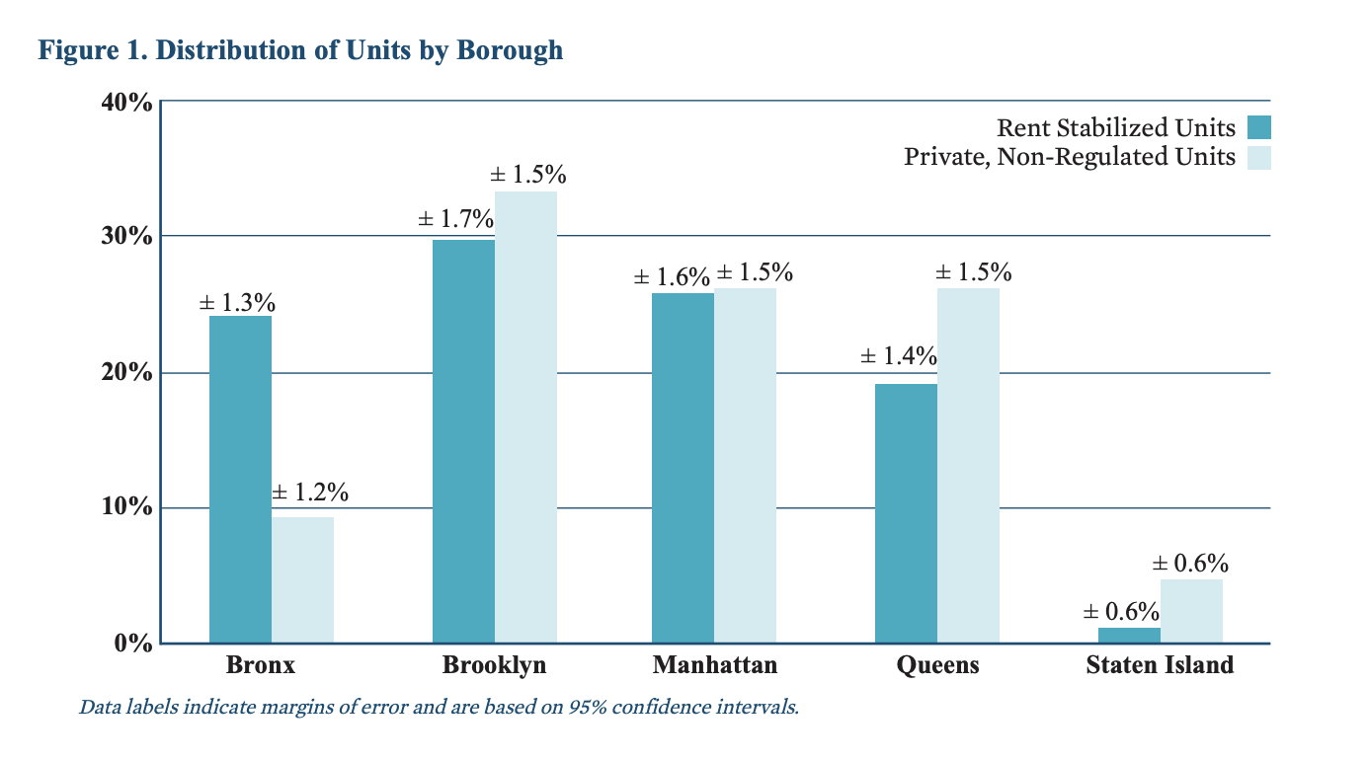
Rent Stabilized Units in NYC
Waickman, C. R., Jerome, J. B. R., Place, R. Sociodemographics of Rent Stabilized Tenants. New York City Department of Housing Preservation and Development, 2018.
Notes:
Jessi
The Bronx has a higher proportion of stabilized units, while the other boroughs have a higher proportion of unregulated units.
The Bronx has always been the epicenter of evictions in NYC, with the highest eviction rate across the boroughs, until Brooklyn took the lead in 2021 and early 2022.
During the pandemic, there were several measures put in place to protect tenants in NYC from eviction, including a statewide eviction moratorium and a rent relief program. However, the specific impact on rent-stabilized versus unregulated tenants varied.
Rent-stabilized tenants had protections in place pre-pandemic, including lease renewal and limited rent increases. These protections continued during the pandemic, with the addition of state rental assistance. Unregulated tenants lacked such protections, causing financial hardship and increased risk of eviction.
This disparity in protections between rent-stabilized and unregulated tenants may have contributed to Brooklyn's higher eviction rates in 2021 and early 2022.

Slide 29
Conclusion & Recommendations

Slide 30
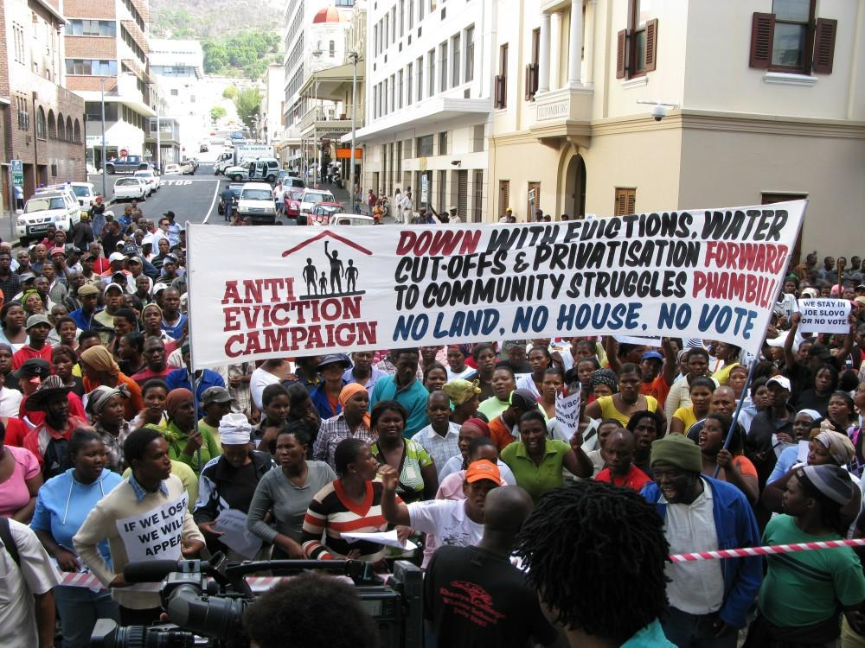
CONCLUSION
Our data shows eviction in New York City is a systemic issue long in the making.
The Bronx has the highest eviction rate of any borough in New York City from 2017-2022. The COVID-19 pandemic has further exacerbated this crisis with many families struggling to make ends meet due to job loss and economic hardship.
Our data uncovered that the high eviction rates in the Bronx are attributed to factors such as low-household income, lack of affordable housing, and rising cost of living. Systemic issues such as racial and income inequality can contribute to higher eviction rates among Black and Latinx tenants.
Notes:
KEY FINDINGS -
Eviction Moratorium NYC over the last years -
Our data shows massive changes in eviction rates in recent years. During 2017-2019, New York City had massive eviction rates. The eviction moratorium in NYC during the COVID-19 pandemic has led to a decrease in evictions in 2020 and 2021. Since, the evictions rate has slightly increased in late 2021 and 2022 due to the extended eviction moratorium laws in NYC during the pandemic. To further understand eviction trends in NYC, it would be worthwhile to investigate the income of neighborhoods with high eviction rates, particularly those with low-income populations.
COVID-19 - Less eviction during the pandemic in 2020/2021
Evictions rate has slightly increased in 2022/2023 due to extended Eviction Moratorium laws in NYC during the Pandemic
Eviction trends in NYC vs the USA?
For next steps, we can dig further on the income of neighborhoods with high eviction rates? Does low income
The housing crisis is a cost of living crisis - intertwined with so many factors - making it difficult to solve -

Slide 31

Our data-driven recommendations:
It is our recommendation that the HPD team focus on systemic changes in high eviction neighborhoods by:
Increasing funding for affordable housing, which can help provide homes for those who are struggling to make ends meet. It can also help to reduce homelessness and poverty and increase economic mobility.
Increasing funding for rental assistance programs, as more families and individuals can receive the support they need to maintain their housing stability and improve their overall well-being.
Expanding access to legal services for tenants, as they can have a fair chance in eviction proceedings and receive the necessary support to protect their rights.
Increasing financial assistance for local businesses located in hotspot areas.
Notes:
We EACH TAKE A BULLET!
Questions to ask
How Vacancy rates affect the eviction rates?
How can policies be improved to mitigate the negative impact of evictions in NYC?
Increase funding for affordable housing.
Increase funding for rental assistance programs.
Expand access to legal services for tenants.
- How does income and demographics lead to higher evictions in some NYC boroughs?

Slide 32
Resources
New York State Homes and Community Renewal. COVID-19 Eviction Protections for Tenants. Retrieved from https://hcr.ny.gov/covid-19-eviction-protections-tenants#:~:text=The%20Tenant%20Safe%20Harbor%20Act,hardship%20due%20to%20COVID%2D19.
The City. (2022, January 13). As Eviction Pause Ends in New York, Here’s What Tenants Should Know. https://www.thecity.nyc/housing/2022/1/13/22882998/as-eviction-pause-ends-in-new-york-heres-what-tenants-should-know.
NYC Council. Evictions in New York City. Retrieved from https://council.nyc.gov/data/evictions/
City Limits. (2022, July 26). NYC evictions have increased every month this year. Retrieved from https://citylimits.org/2022/07/26/nyc-evictions-have-increased-every-month-this-year/
2020 Census - New York City Population. NYC.gov, The City of New York, n.d., https://www.nyc.gov/site/planning/planning-level/nyc-population/2020-census.page.
Demographic Map Viewer." U.S. Census Bureau, 2021, https://www.census.gov/library/visualizations/2021/geo/demographicmapviewer.html.
Waickman, Corey R., et al. "Sociodemographics of Rent Stabilized Tenants." New York City Department of Housing Preservation and Development, 2018.
RentHop. "Average Rent in New York, NY." RentHop, RentHop, n.d., https://www.renthop.com/average-rent-in/new-york-ny.
Notes:
Formatting MLA ? or Footnotes?

Slide 33


